Slide 1

Steel Sentinel
Made by chirag & ISHAN (group no.5)

Slide 2
Introduction
Today we are here to present our new first-person shooter game, built using the raycasting method for creating immersive, 3D environments.
In this game, players take on the role of a skilled marksman, tasked with completing various missions and objectives in a series of challenging levels. The game uses a series of rays to simulate the player's line of sight, creating the appearance of a 3D environment even on a 2D screen. This allows players to see and interact with the game world from a first-person perspective, just like they're really there.
Thanks to our advanced raycasting engine, players will experience a level of realism and immersion like never before. The game features a variety of environments, from dark and foreboding corridors to wide-open outdoor spaces, all while taking out enemy targets and avoiding hazards along the way.
But be warned - this game isn't for the faint of heart. Players will need to use all of their skills and tactics to take down enemy targets, avoid traps and hazards, and complete their objectives before time runs out. With challenging gameplay, realistic graphics, and a fully immersive experience, our new shooting game is sure to keep players on the edge of their seat for hours on end.
Overall, our new shooting game is a perfect example of how the raycasting method can be used to create immersive, realistic 3D environments in video games. So, whether you're a fan of first-person shooters or simply interested in the latest gaming technology, be sure to check out our new game!

Slide 3
AIM
The basic aim of a fighting game is to defeat an opponent or opponents through a combination of various moves and techniques such as punches, kicks, throws, and special moves. Typically, fighting games involve one-on-one combat in a two-dimensional or three-dimensional arena, with each player having a health bar that decreases as they take damage from their opponent's attacks. The goal is to reduce the opponent's health bar to zero before they can do the same to you. Winning a fighting game often requires a combination of skill, strategy, timing, and quick reflexes.

Slide 4
ROADMAP
Create a game engine: The first step in creating a shooting game using raycasting is to create a game engine that can handle the complex math and rendering required for raycasting. This will involve designing an algorithm for casting rays, detecting collisions with objects in the game world, and rendering the visible parts of the game world onto the player's screen.
Design the game world: Once the game engine is in place, the next step is to design the game world. This will involve creating a series of levels with a variety of environments, such as indoor corridors, outdoor landscapes, and more. You will need to design objects such as walls, floors, and enemies that can be detected by the raycasting algorithm.
Implement player movement: With the game world in place, you'll need to implement player movement. This will involve designing a system for moving the player's position and orientation based on user input, such as keyboard.
Add shooting mechanics: Once player movement is implemented, the next step is to add shooting mechanics. This will involve designing a system for firing projectiles from the player's weapon, detecting collisions with enemies and other objects in the game world, and updating the game state accordingly.
Implement game logic: Finally, you'll need to implement the game logic that ties everything together. This will involve designing a system for tracking the player's progress through the game, scoring, and more.
Test and iterate: Once the game is implemented, you'll need to thoroughly test it to ensure that everything works as intended. You'll also want to get feedback from players and iterate on the design as necessary to improve gameplay, graphics, and overall user experience.

Slide 5
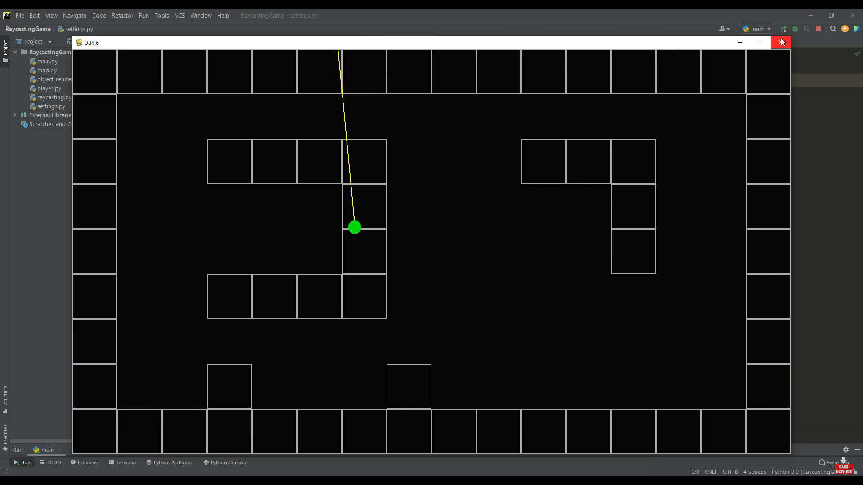
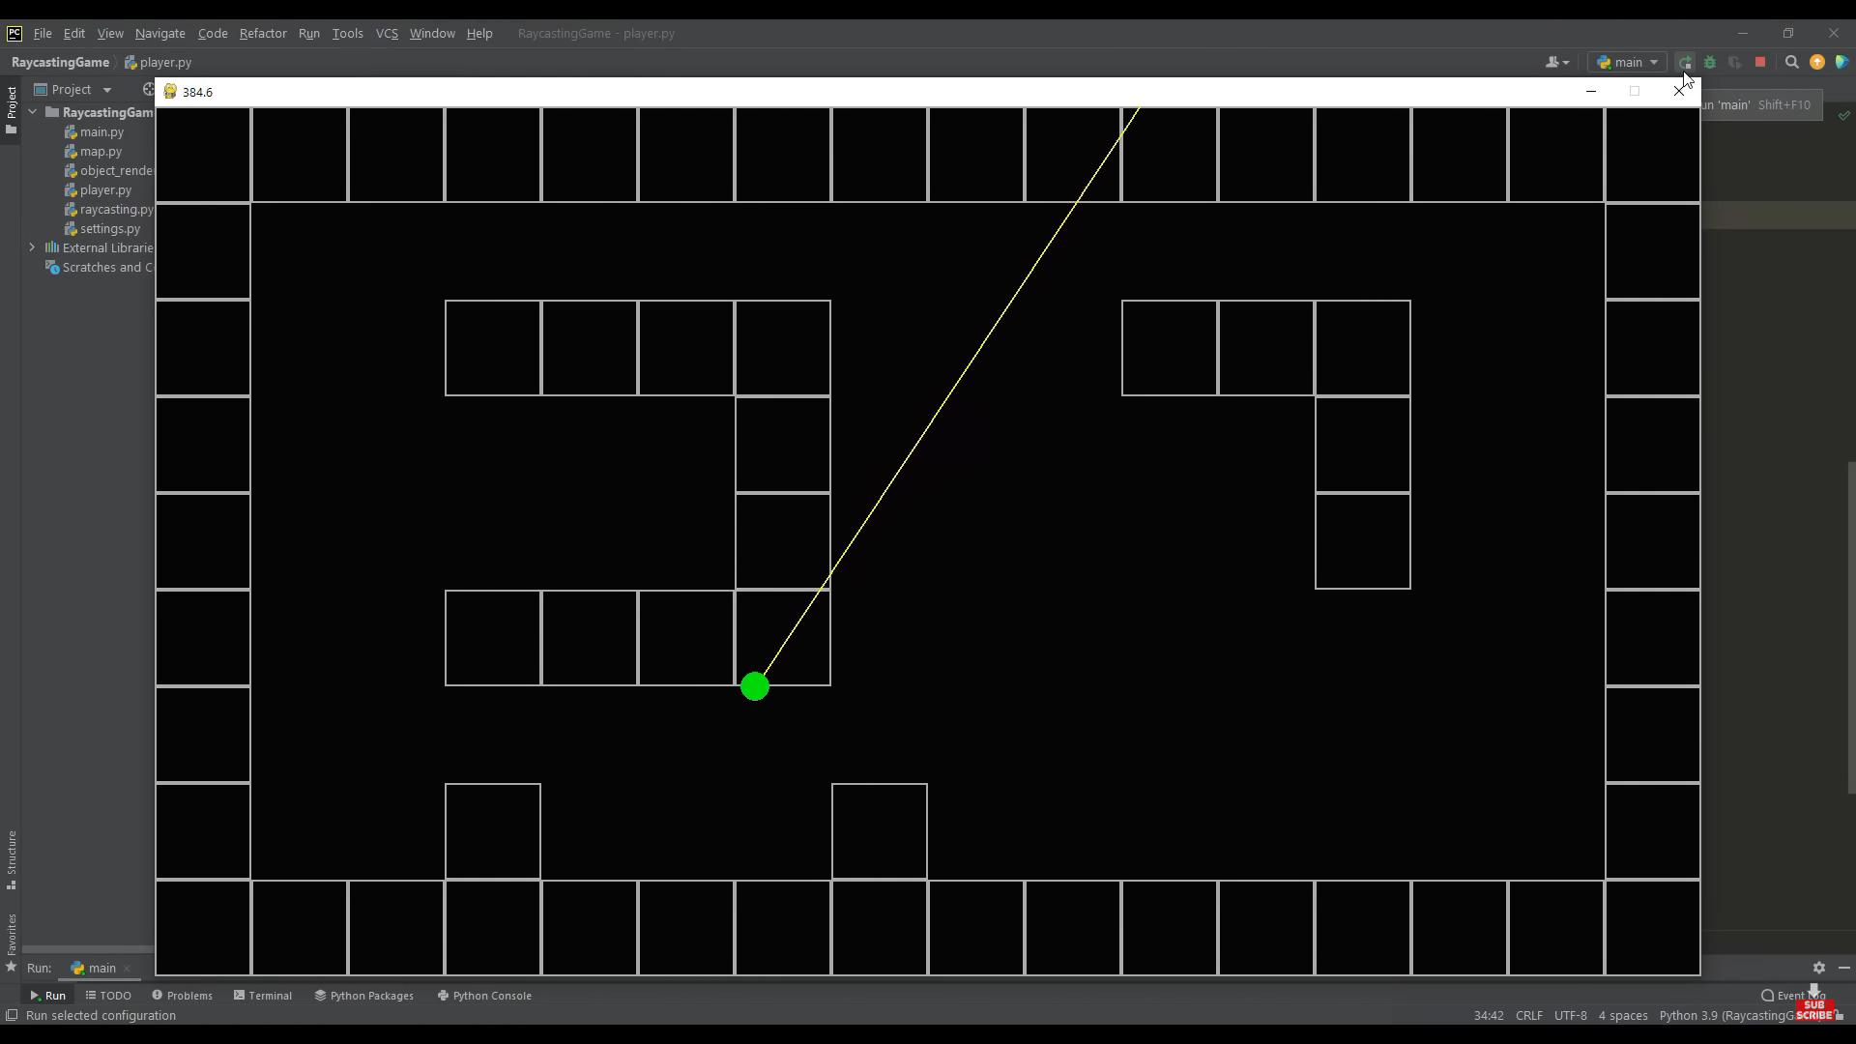
have not defined wall to define this , we must add a check system to do this we check that if the checked coordinates hit the wall. Game keeps checking the coordinates of player now. We have also defined collision method so that no player cannot go through walls (left one is the before and right is after)

Slide 6
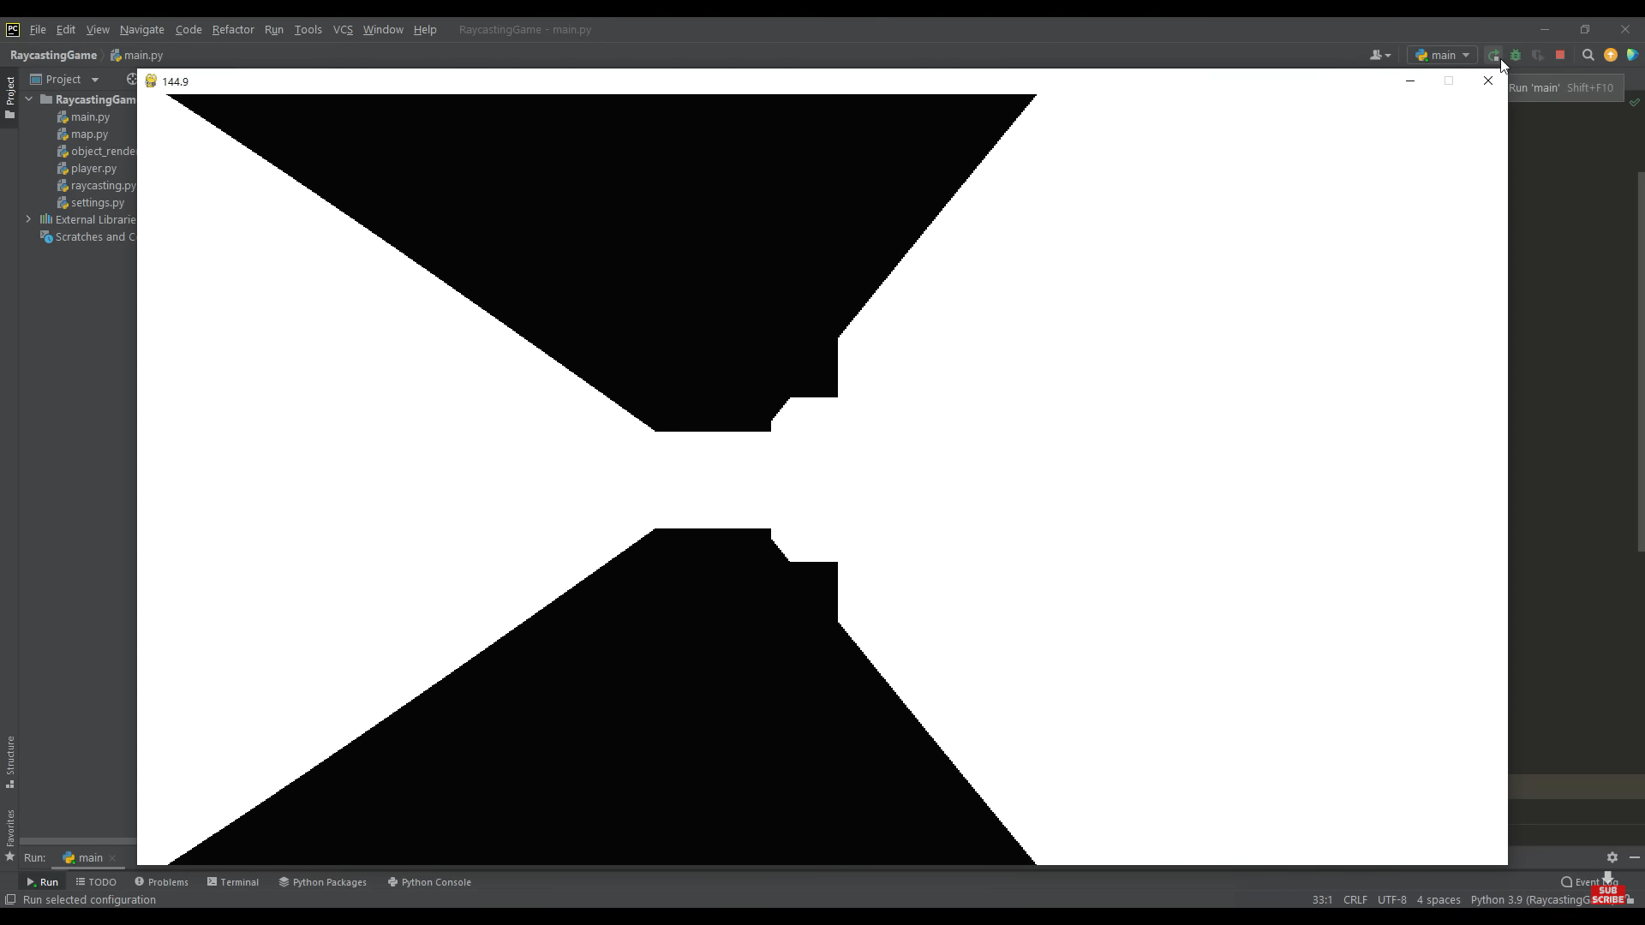
First PSEDO 3d projection of game

Slide 7
EXSISTING TECHNIQUES
Game programming is very rewarding nowadays and it can also be used in advertising and as a teaching tool too.
Game development includes mathematics, logic, physics, AI, and much more.
Using ray casting as it provides good user experience in a 2d game .
In python, game programming is done in pygame and arcade and it is one of the best modules for doing so.
For our project , we are using pygame.
So what is pygame?

Slide 8
WHAT IS BASICALLY PYGAME?
Pygame is a Python library that is used for building games and multimedia applications.
What makes pygame unique is its predefined keywords which help in a lot ways for user to create a game
Here are some of the most commonly used predefined keywords in Pygame:
pygame.init() - Initializes all the Pygame modules
pygame.display.set_mode() - Sets the size and display mode of the Pygame window
pygame.quit() - Quits Pygame
pygame.display.update() - Updates the display surface
pygame.time.Clock() - Creates a new clock object that can be used to control the game's frame rate

Slide 9
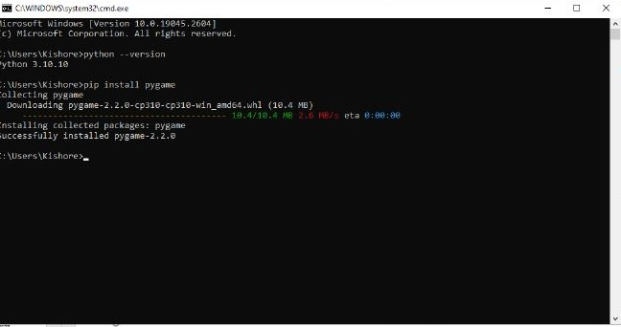
HOW To install pygame
Basically all we have to do is first install python (for instance version 3.10.10) from there official website and go to command prompt and type “pip install pygame”

Slide 10
What is RAYcasting
Raycasting is a popular technique used in game development to create 3D environments, such as those found in first-person shooter games. The basic idea behind raycasting is to simulate the behavior of light rays in a 3D environment in order to determine what objects are visible from a particular point of view.
Raycasting is still used in games like Minecraft (Minecraft uses a modified version of the raycasting algorithm to generate its blocky, voxel-based environments)
Other game examples are Doom, Wolfenstein 3D & Duke Nukem 3D.

Slide 11
How raycasting works in a game
First, the game determines the player's position and orientation in the 3D world.
The game then casts a series of rays from the player's position in all directions, forming a "field of view" for the player.
Each ray is checked to see if it intersects with any objects in the game world. This is typically done using a technique called "bounding box" collision detection, where each object in the game world is represented by a rectangular box.
If a ray intersects with an object, the game determines which part of the object is visible from the player's point of view. This is typically done by projecting the object onto the player's view plane and determining which pixels of the object are visible.
The game then uses this information to render the visible parts of the game world onto the player's screen, typically using a technique called "texture mapping" to create the appearance of 3D objects on a 2D screen.
The process is repeated for each frame of the game, allowing the player to move around and explore the game world in real-time.

Slide 12
HOW THE game works?
In a shooting game using raycasting, the game world is created as a series of 2D maps or levels, which are rendered onto the player's screen using a technique known as raycasting.
The game engine casts rays out from the player's position, determining which objects and surfaces are visible within the player's field of view. Based on this information, the engine then renders the visible parts of the game world onto the player's screen, creating the appearance of a 3D environment.
The engine uses a series of calculations to determine the position and orientation of objects and surfaces within the game world. These calculations take into account the angle and distance of the rays that are cast, as well as the position and orientation of the player within the game world.
When the player fires their weapon, the engine casts a ray from the player's weapon to determine whether it has hit an enemy or other object within the game world. If the ray intersects with an object, the engine calculates the damage done to that object and updates the game state accordingly.
Enemy AI is also implemented using raycasting. The game engine casts rays from the enemy's position to detect the player's location and orientation, and then updates the enemy's behavior accordingly. For example, an enemy might move towards the player's location or attempt to attack the player if they are within range.
Overall, raycasting allows for the creation of a realistic 3D environment in a shooting game, without requiring the complex 3D rendering techniques used in other types of games. This technique has been used in classic games such as Wolfenstein 3D and Doom.

Slide 13
CONTROLS
Controls:-
The user can control the player using W,A,D which will result in
W:-Jump,
A:-Left,
D:-Right movements.
S- Back movement.
Left mouse to shoot.

Slide 14

Interactive gameplay
For interactive gameplay of the user we have taken the following steps:
When player takes damage from npc the screen turns red
If player takes damage from enemies and hides from enemies the health regenerates
Added more npcs like CYBER Demon, soldier, caco demon adding there specific health, speed, damage etc
We have added background sounds as well as demon death sounds gun shooting sound, player pain sound etc.
Demon death sound:

Slide 15
ADVANTAGES OF OUR GAME
Easy to learn and use: Python is a simple and easy-to-learn language, which makes it a popular choice for beginners who are just starting to learn programming.
Large community: Python has a large and active community of developers who are constantly creating new libraries, modules, and frameworks that can be used to develop games.
Cross-platform compatibility: Python code can be easily run on various operating systems such as Windows, macOS, and Linux, making it a great choice for developing games that can be played on multiple platforms.
Wide range of libraries and modules: Python has a large number of libraries and modules that can be used for game development, including Pygame, Arcade, and more.
Versatility: Python can be used for a wide range of applications, including game development, machine learning, web development, and more. This means that learning Python for game development can be a valuable skill that can be applied to many other areas of software development.

Slide 16
Conclusion
In conclusion, raycasting is a powerful technique for creating 3D environments in video games. It has been used in numerous classic and modern shooting games to create a fast-paced and immersive experience for players. By casting rays from the player's position and rendering visible parts of the game world, raycasting can create the illusion of a 3D environment, without the need for complex 3D rendering techniques. Implementing raycasting in a shooting game involves creating a game engine that can handle complex math and rendering, designing the game world, implementing player movement and shooting mechanics, and developing enemy. With careful planning and execution, a shooting game using raycasting can be an exciting and engaging experience for players.

Slide 17
References used
https://rosettacode.org/wiki/Ray-casting_algorithm
Assets - https://spritedatabase.net/game/760 ( all the images are taken from here)
https://fontmeme.com/fonts/turok-font/
https://freesound.org/people/mrrap4food/sounds/493918/
https://www.youtube.com/watch?v=s5bd9KMSSW4
https://www.geeksforgeeks.org/pygame-tutorial/#:~:text=Python%20PyGame%20library%20is%20used,be%20wrapped%20in%20standalone%20executables.
https://stackoverflow.com/questions/27388767/point-in-polygon-ray-casting-algorithm
https://killerrobotics.me/2021/08/13/raycasting-game-in-python-and-pygame-part-1/comment-page-1/
https://www.pygame.org/project/4885
https://www.youtube.com/watch?v=ECqUrT7IdqQ&list=PLi77irUVkDatlbulEY4Kz8O107HO8RGH8

Slide 18
THANK YOU

